Slide 1


Text Classification: Emotion Detection as a Case Study
Malak Abdullah
Assistant Professor of the computer science department at
Jordan University of Science and Technology

Slide 2

Outline
Text Classification Overview
Emotion and Sentiment Definitions
Motivation for Sentiment and Emotion Detection
Text Classification Workflow
Text Classification Approaches
More Resources

Slide 3
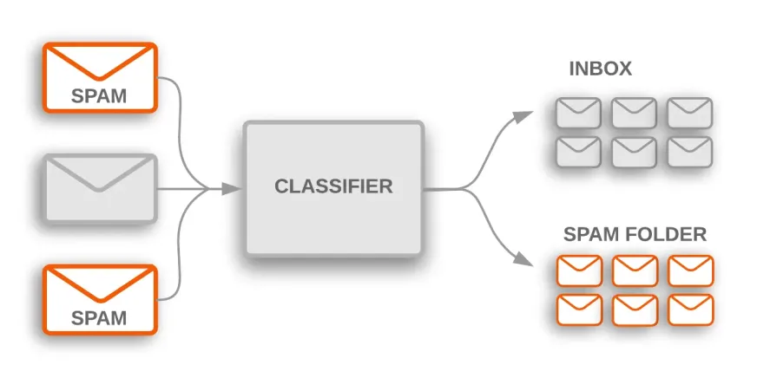
Text Classification

Slide 4
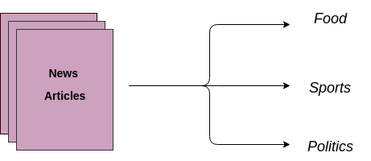
Text Classification
Text classification is the process of categorizing the text into a group of words.
It is a machine learning technique that assigns a set of predefined categories to text.

Slide 5

Why is Text Classification Important?
Text classifiers can be used to organize, structure, and categorize pretty much any kind of text – from documents, medical studies and files, and all over the web.
Text classification is one of the fundamental tasks in natural language processing with broad applications such as sentiment analysis, emotion detection, topic labeling, and spam detection.

Slide 6
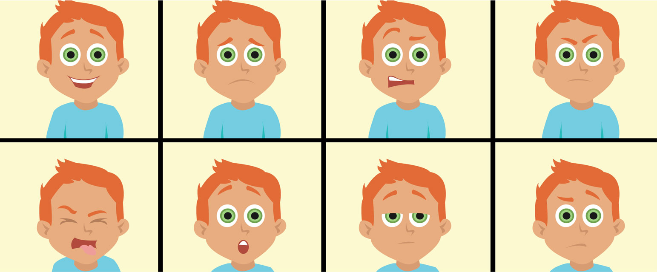
What is Emotion?
Emotion can be conveyed in several forms:
Face and movements
Voice
Written language

Slide 7
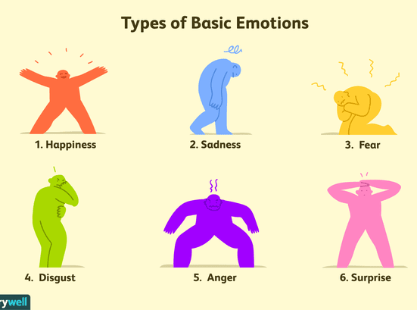
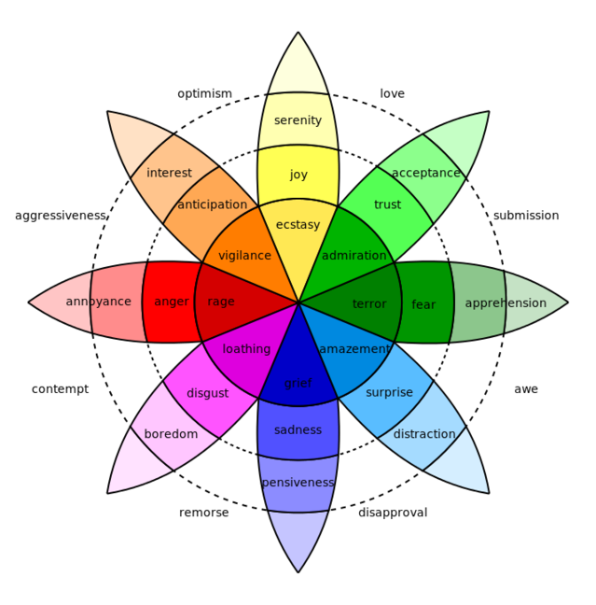
Basic Emotions
During the 1970s, psychologist Paul Eckman identified six basic emotions that he suggested were universally experienced in all human cultures.
The emotions he identified were happiness, sadness, disgust, fear, surprise, and anger.
He later expanded his list of basic emotions to include such things as pride, shame, embarrassment, and excitement.

Slide 8
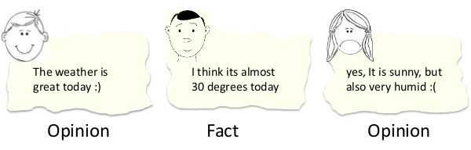






Sentiment vs Emotion
Sentiment Analysis aims to detect positive, neutral, or negative opinions, emotions, and evaluations from text
Emotion Analysis aims to detect and recognize types of feelings through the expression of texts, such as anger, disgust, fear, happiness, sadness, and surprise
Joy sad surprise disgust fear anger

Slide 9


Motivation
Millions of users post their opinions on a variety of subjects everyday
Microblogging web-sites are playing a vital role in influencing people’s opinion in a specific direction
Whenever we need to make a decision, we want to know others’ opinions

Slide 10

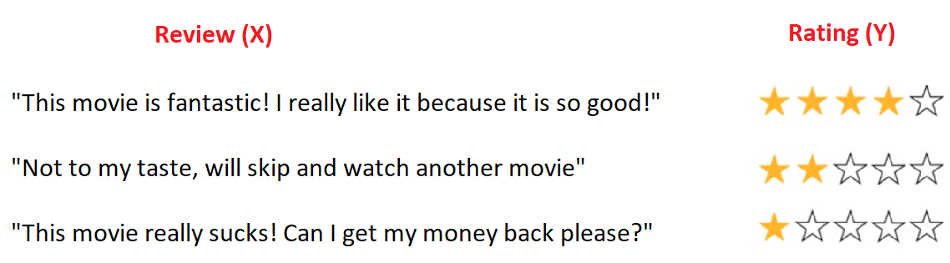
Customer feedback
Reviews
Customer support
Product branding
Understanding the emotional content of text can provide valuable insights about users or the content:

Slide 11
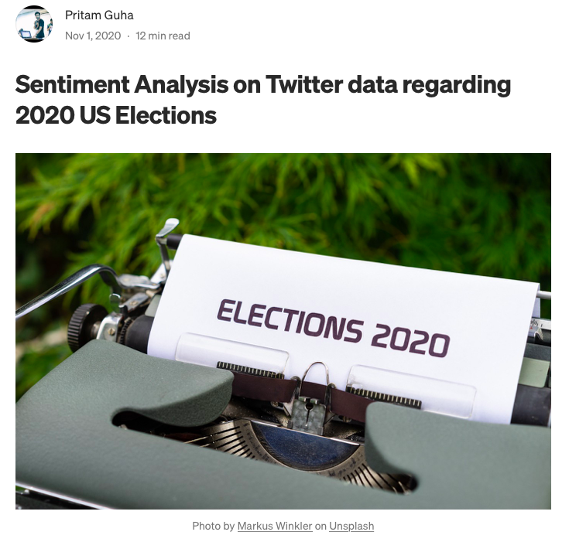
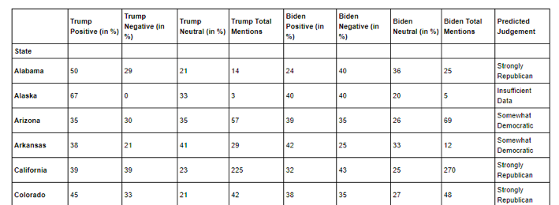
Sentiment Analysis on Twitter data regarding 2020 US Elections
In this analysis, they were concerned with finding the political mood of each and every US state from the twitter data.
https://towardsdatascience.com/sentiment-analysis-on-twitter-data-regarding-2020-us-elections-1de4bedbe866

Slide 12
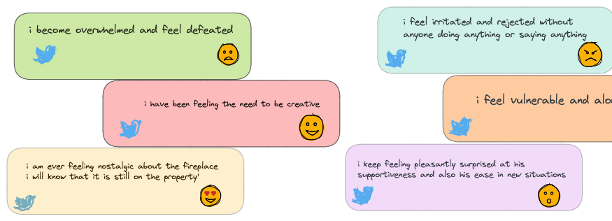
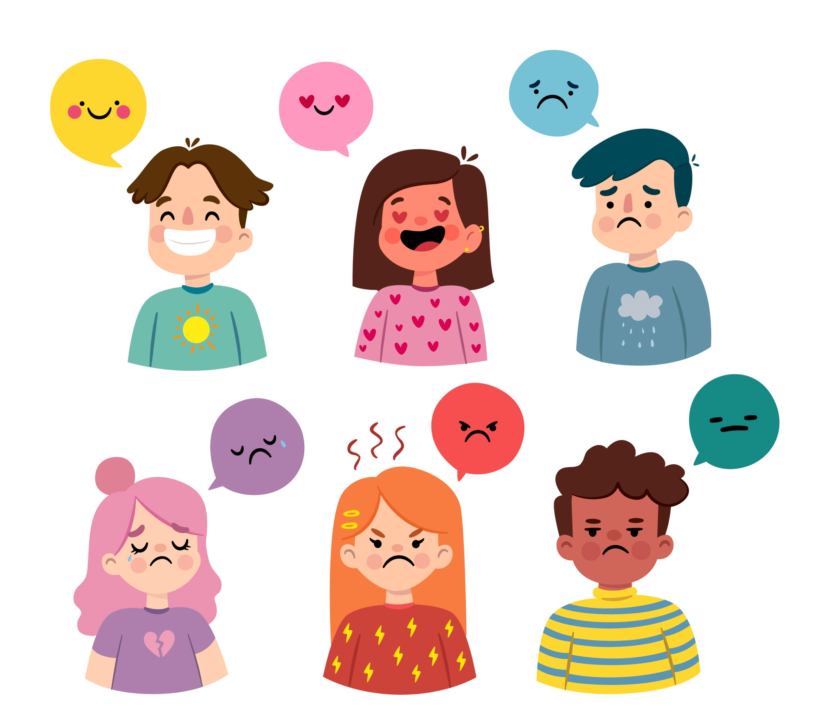
Detecting Emotion in Text

Slide 13
Tripod of Sentiment and Emotion Detection
Natural Language Processing
Sentiment &
Emotion
Detection
Machine/Deep Learning
Cognitive Science

Slide 14
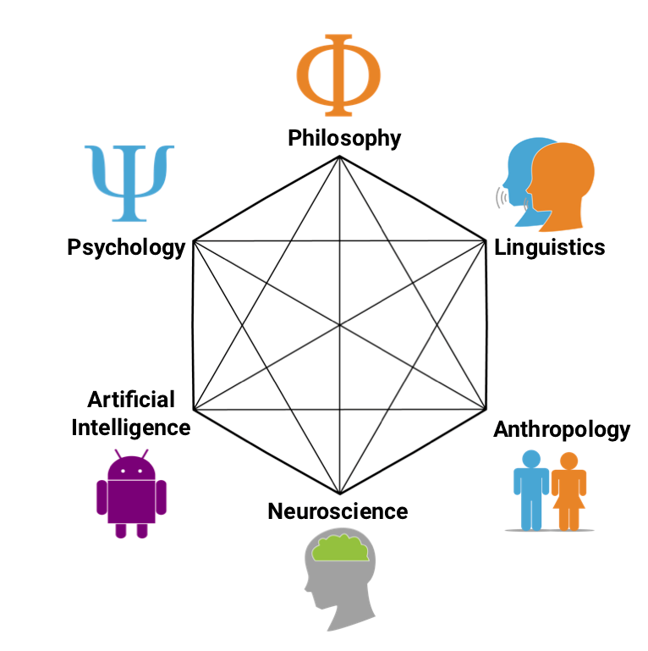
Cognitive Science
The interdisciplinary scientific investigation of the mind and intelligence.
It encompasses the ideas and methods of psychology, linguistics, philosophy, computer science, artificial intelligence (AI), neuroscience, and anthropology.
Notes:
Cognitive science is the study of the human mind and brain, focusing on how the mind represents and manipulates knowledge and how mental representations and processes are realized in the brain.

Slide 15

Machine Learning
Machine learning technology teaches computers how to perform tasks by learning from data instead of being explicitly programmed.

Slide 16
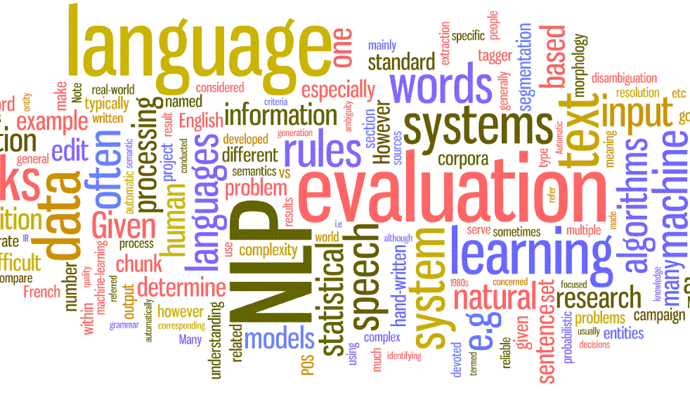
Natural Language Processing
The field of study that focuses on the interactions between human language and computers is called natural language processing, or NLP for short.
Natural language processing (NLP) is a field of artificial intelligence in which computers analyze, understand, and derive meaning from human language in a smart and useful way.

Slide 17
Text Classification Workflow
For instance, given a tweet, you create a model to classify the tweet as being joy, sad, anger, etc.
Reading Text file
Tweet 1 joy
Tweet 2 anger
Tweet 3 sad
Tweet 4 joy
Tweet 5 no emotion
Tweet 6 joy
Tweet 7 anger
Clean the text
Extract Features
Build a Model
Evaluation

Slide 18
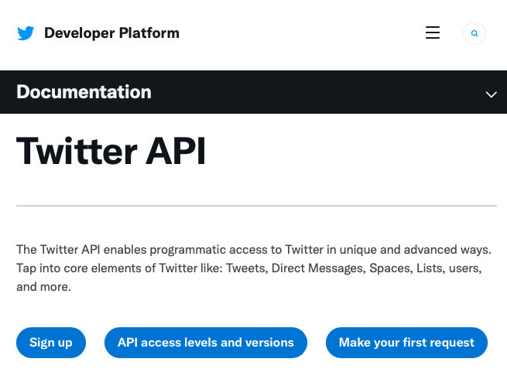
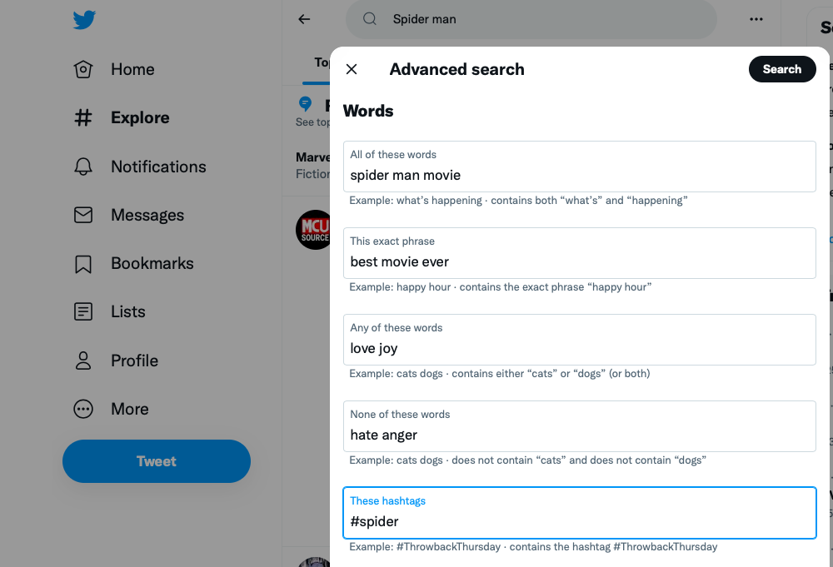
We need data!
For example, Twitter data
It can be fetched from the official API
You need API credentials
Using the library tweepy to access the API and search for any query

Slide 19
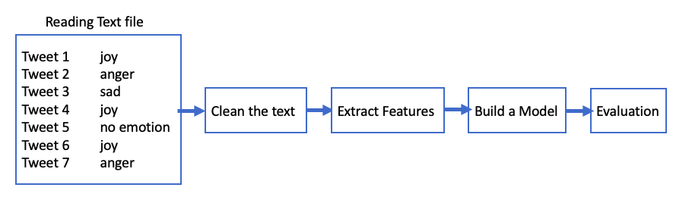
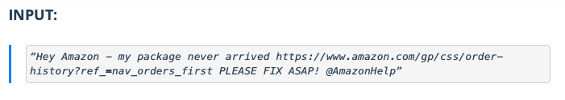
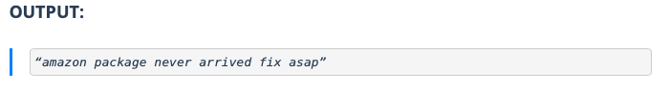
Data Cleaning
Data cleaning is the process of fixing or removing incorrect, corrupted, incorrectly formatted, duplicate, or incomplete data within a dataset.
Text cleaning can be performed using simple Python code that
eliminates stopwords
removes unicode words
simplifies complex words to their root form
and others

Slide 20
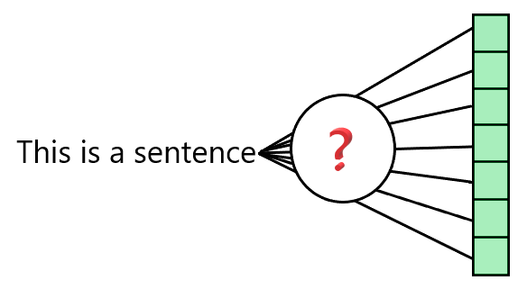
Features Extraction
Computers understand numbers, but can’t understand characters, words, or sentences, so an intermediate step is needed before building NLP models, which is text representation or text vectorization.
Text Vectorization: convert text to vector of numbers

Slide 21

Text Vectorization Terminology
Before understanding Vectorization, there are few terms that we need to understand.
Document: A document is a single text data point. For Example, a review of a particular product by the user.
Doc1: This is a good product; I will buy it again.
Doc2: I hate this product.
Doc3: My sister bought this product, and I am thinking of buying this too.

Slide 22
Text Vectorization Terminology
Corpus: A collection of all the documents present in our dataset.
Feature: Every unique word in the corpus is considered as a feature.
[brown, house, big, street, number, small, bedroom, dog,…etc]
Text 0: "This is a brown house. This house is big. No street number." Text 1: "This is a small house. This house has a bedroom. The street number is 12." Text 2: "This dog is brown. This dog likes to play." Text 3: "The dog is in the bedroom."
Corpus

Slide 23
Text Vectorization Techniques
Some popular methods to accomplish text vectorization:
Binary Term Frequency
Bag of Words (BoW) Term Frequency
N-gram vectorization
TF-IDF
The vector size for a particular document is equal to the number of unique words present in the corpus.

Slide 24
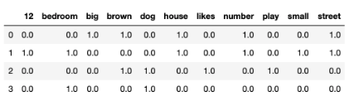
Binary Term Frequency
Binary Term Frequency captures presence (1) or absence (0) of term in document.
Text 0: "This is a brown house. This house is big. No street number." Text 1: "This is a small house. This house has a bedroom. The street number is 12." Text 2: "This dog is brown. This dog likes to play." Text 3: "The dog is in the bedroom."
Corpus
sparse matrix

Slide 25
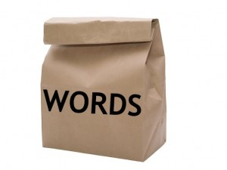
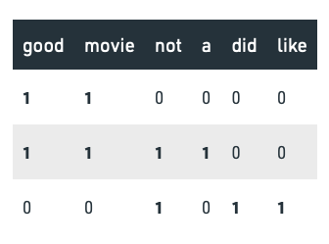
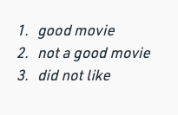
Bag of Words (BOW)
Bag-of-Words is one of the most fundamental methods to transform tokens into a set of features.
Bag of Words (BoW) Term Frequency captures frequency of term in document.

Slide 26

Drawback
The order of occurrence of words is lost, as we create a vector of tokens in randomized order

Slide 27
N-grams Vectorization
Similar to the BOW technique, in the N-Gram method, a document term matrix is generated, and each cell represents the count.
The columns represent all columns of adjacent words of length n.
BOW is a special case of N-Gram where n=1.
N-grams consider the sequence of n words in the text; where n is (1,2,3.. ) like 1-gram, 2-gram for token pair.
Unlike BOW, it maintains word order.

Slide 28
N-grams Vectorization example
“I am studying NLP” has four words and n=4.
if n=2, i.e bigram, then the columns would be :
[“I am”, “am studying”, ‘studying NLP” ]
if n=3, i.e trigram, then the columns would be :
[“I am studying”, ”am studying NLP”]
if n=4,i.e four-gram, then the column would be :
[“I am studying NLP”]

Slide 29
Why N-grams Vectorization?
It is considered a one way to enrich the representation of your features
The intuition here is that bi-grams and tri-grams can capture contextual information compared to just unigrams.
For example, good food carries more meaning than just good and food

Slide 30
Drawback
Using N-grams can result in a huge sparse (has a lot of 0’s) matrix, if the size of the vocabulary is large, making the computation really complex!!

Slide 31
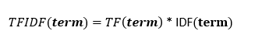
TF-IDF
TF-IDF stands for “Term Frequency — Inverse Document Frequency”
It is about computing a score for each word to signify its importance in the document and corpus

Slide 32
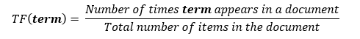
We start with TF
Term Frequency: measures the frequency of a word in a document.
If we take two documents with 100 words and 10,000 words respectively, there is a high probability that the common word “was” is present more in the 10,000 worded document.
But we cannot say that the longer document is more important than the shorter document.
For this exact reason, we perform normalization on the frequency value, we divide the frequency with the total number of words in the document.

Slide 33
What about IDF? Let’s start with DF ☺
Document Frequency: measures the importance of documents in a whole set of the corpus.
DF is the count of occurrences of term t in the document set N. In other words, DF is the number of documents in which the word is present.
We consider one occurrence if the term is present in the document at least once, we do not need to know the number of times the term is present.

Slide 34
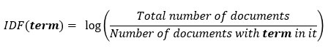
IDF?
Inverse Document Frequency: is the inverse of the document frequency which measures the informativeness of term t.
When we calculate IDF, it will be very low for the most occurring words such as stop words (because they are present in almost all of the documents, and N/df will give a very low value to that word). This finally gives what we want, a relative weightage.

Slide 35
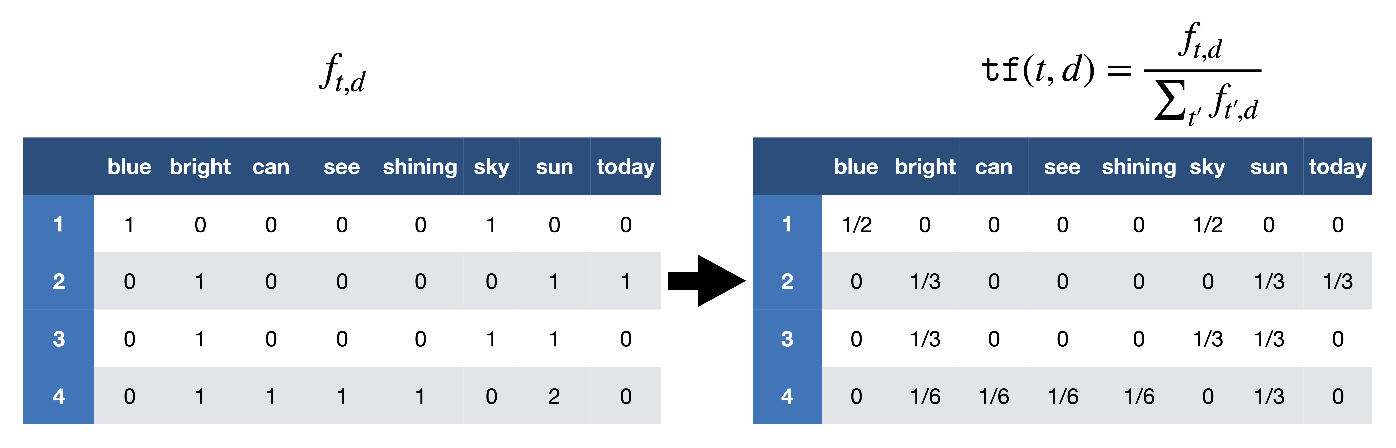
TF-IDF example
After removing the stopwords, we have
d1​: "sky blue
d2​: "sun bright today”
d3​: "sun sky bright”
d4​: "can see shining sun bright sun"
TF

Slide 36
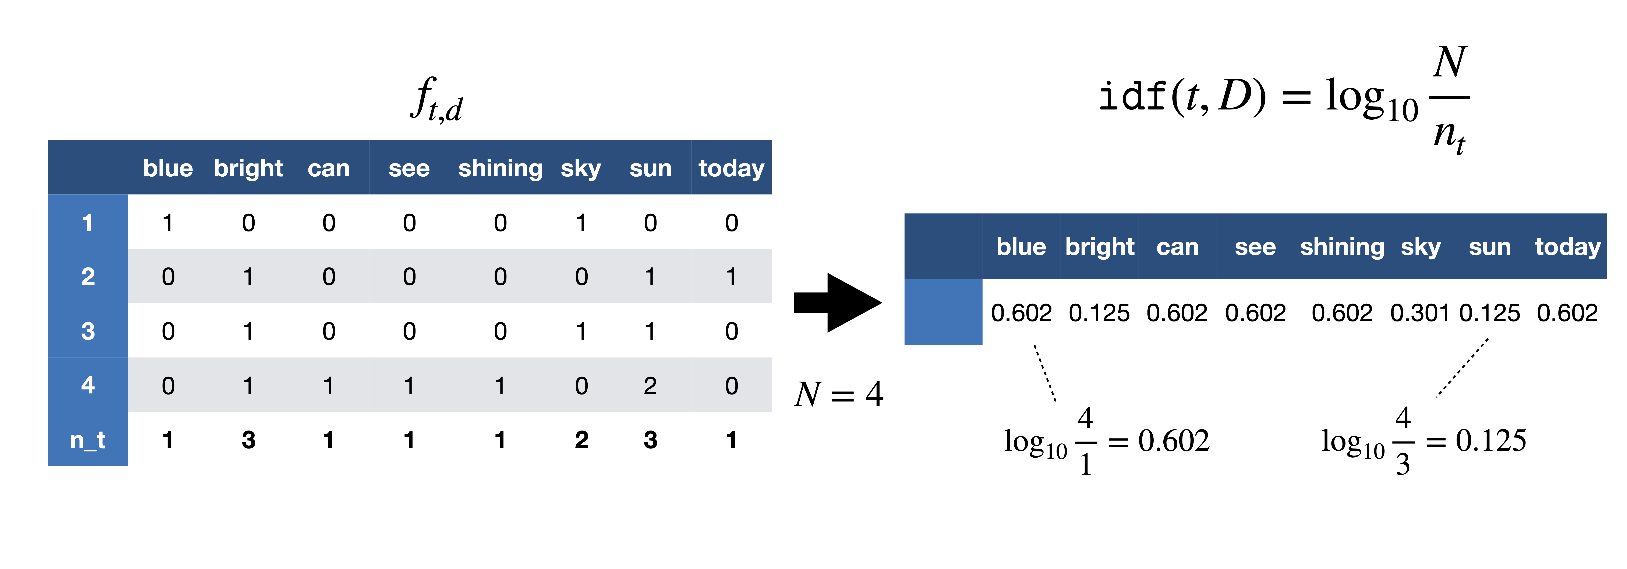
TF-IDF example: Continue
After removing the stopwords, we have
d1​: "sky blue
d2​: "sun bright today”
d3​: "sun sky bright”
d4​: "can see shining sun bright sun"
IDF

Slide 37
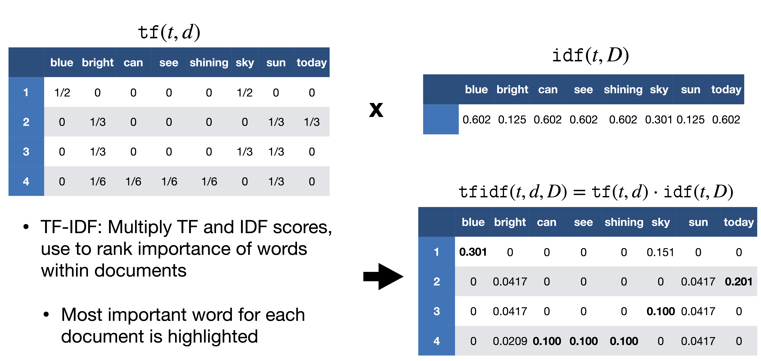
TF-IDF example: Continue
d1​: "sky blue
d2​: "sun bright today”
d3​: "sun sky bright”
d4​: "can see shining sun bright sun"
TF-IDF

Slide 38
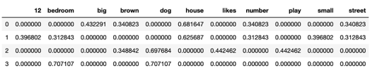
Another TF-IDF Example
Term Frequency–Inverse Document Frequency
Text 0: "This is a brown house. This house is big. No street number." Text 1: "This is a small house. This house has a bedroom. The street number is 12." Text 2: "This dog is brown. This dog likes to play." Text 3: "The dog is in the bedroom."
Corpus
sparse matrix

Slide 39
Drawback
TF-IDF is based on BoW model, therefore it does not capture position in text, semantics, co-occurrences in different documents, etc.
It cannot capture semantics (e.g., as compared to topic models, word embeddings)

Slide 40
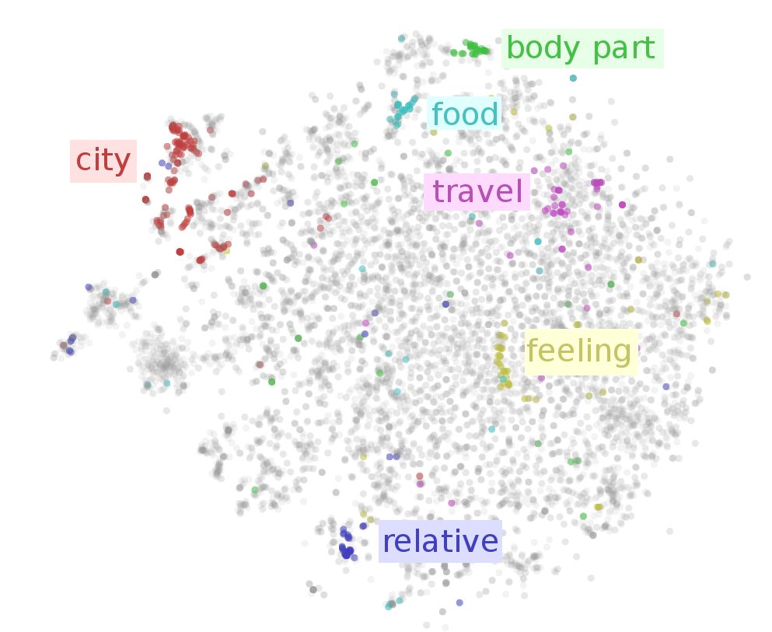

What is Word Embeddings?
Dense Vector representations of words

Slide 41
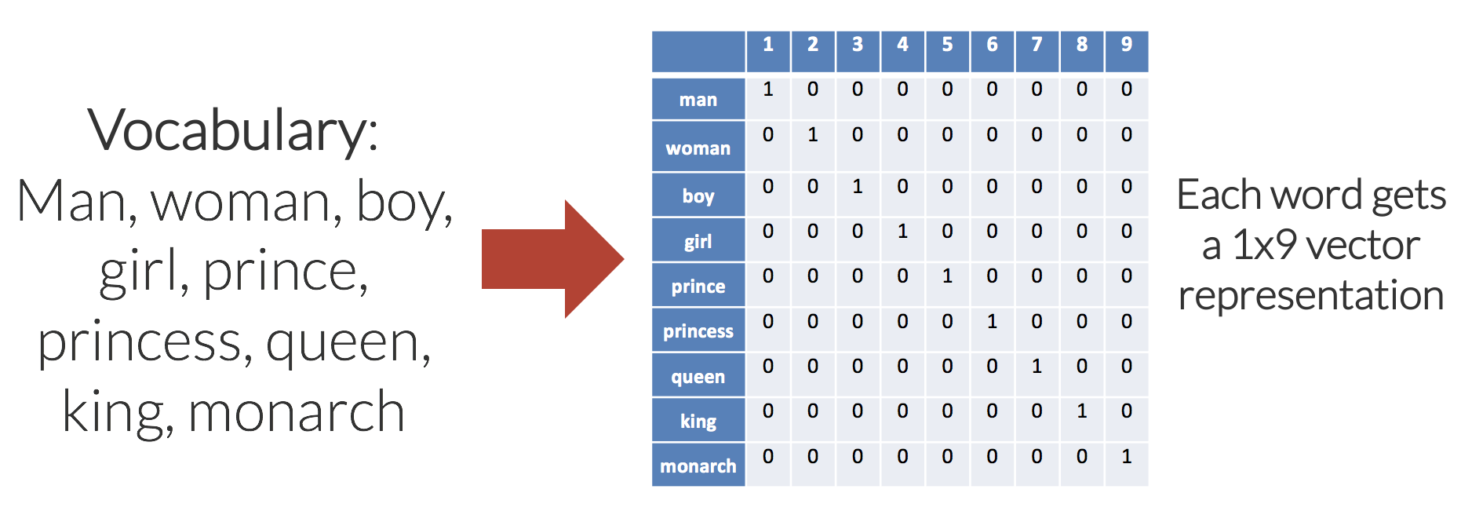
One Hot Encoding
The embedding space has the same number of dimensions as the number of words in the vocabulary; each word embedding is predominantly made up of zeros, with a “1” in the corresponding dimension for the word.
Man = 100000000
Woman = 010000000
etc
Sparse Matrix ☹

Slide 42
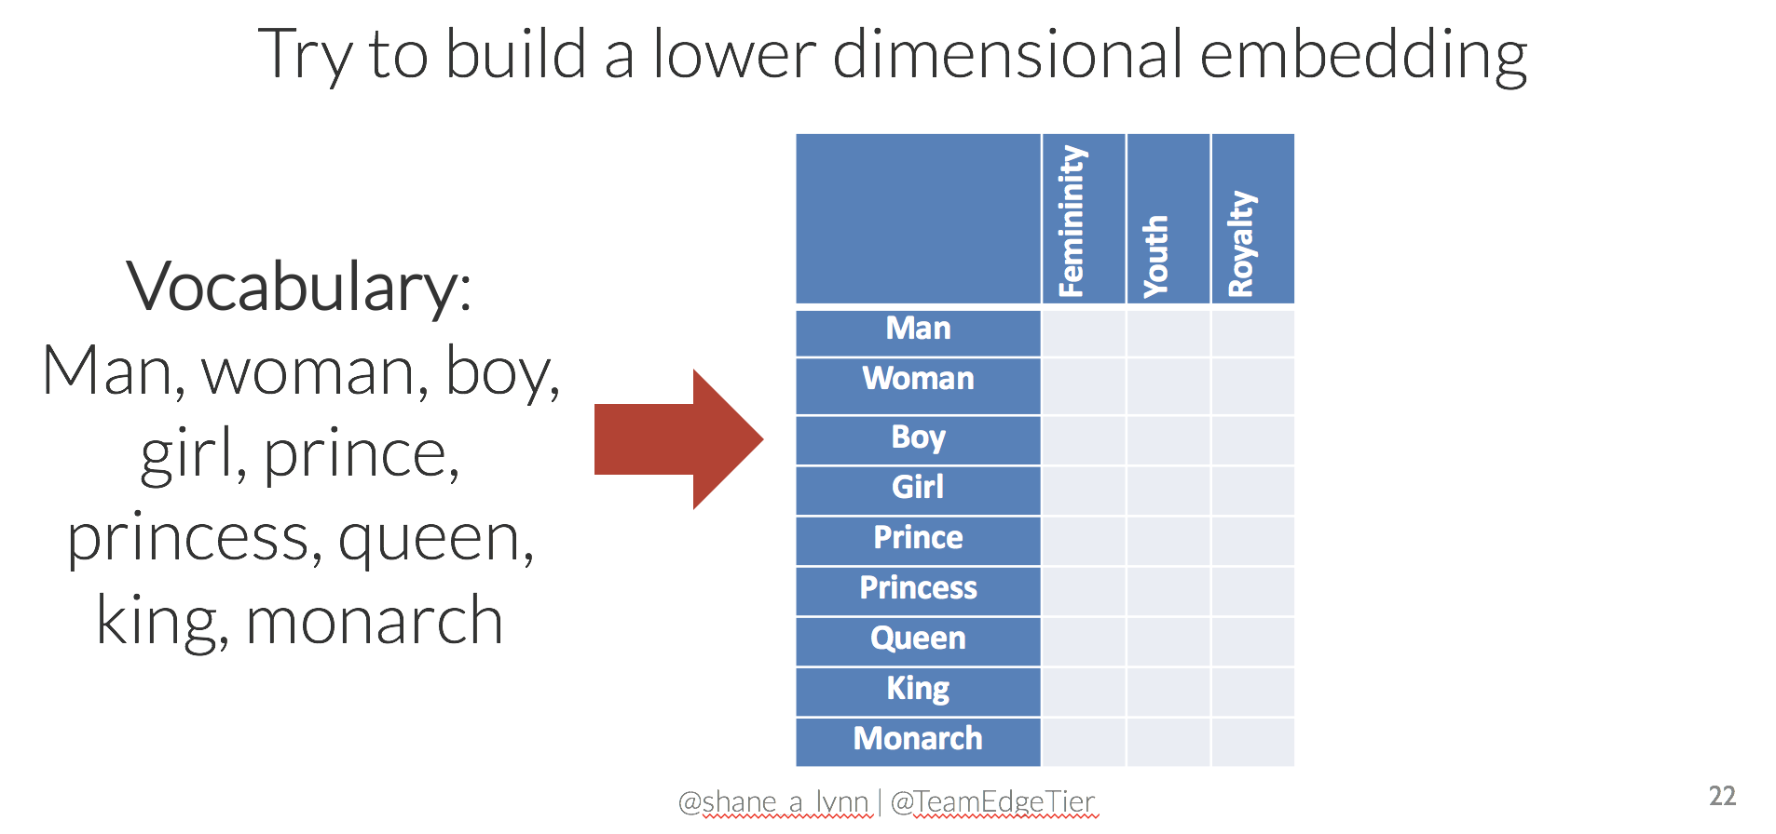
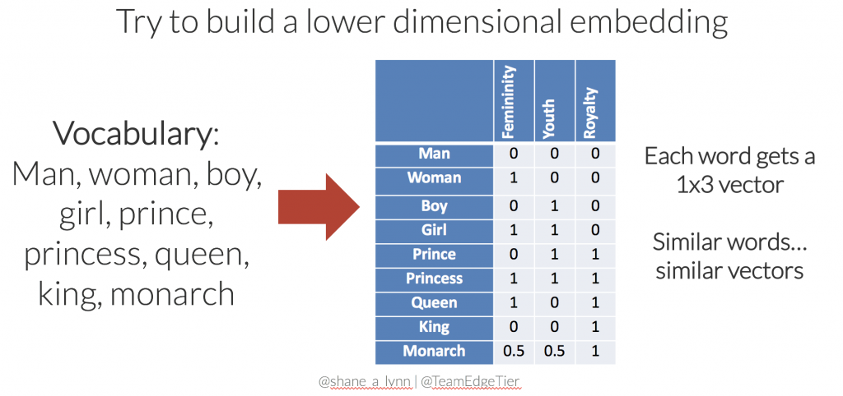
Custom Encoding (Reduce dimensions)

Slide 43
Comparison

Slide 44
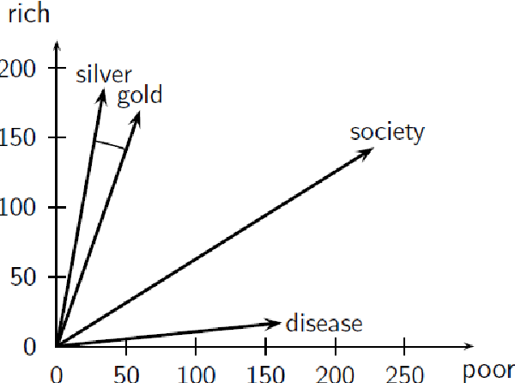
Vector Space Model

Slide 45
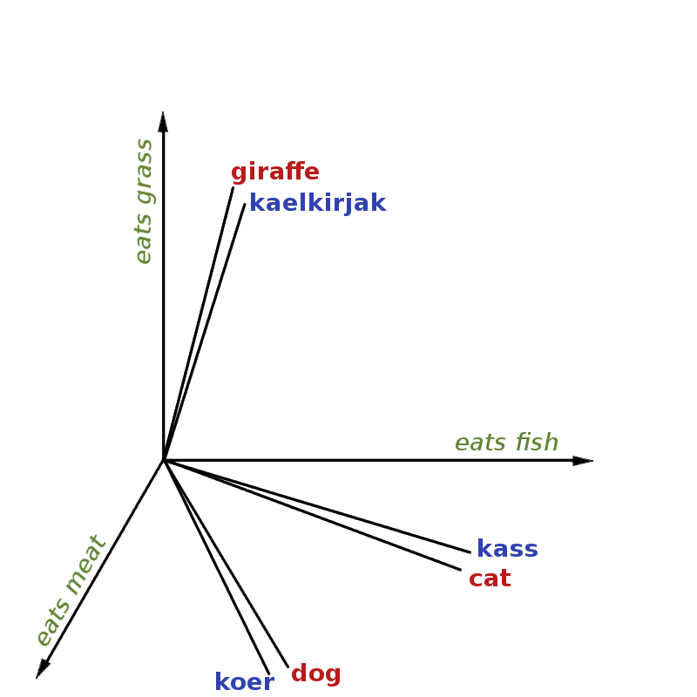
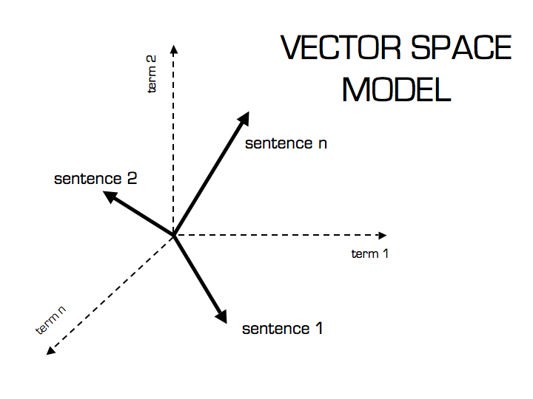
More about Vector Space Model

Slide 46
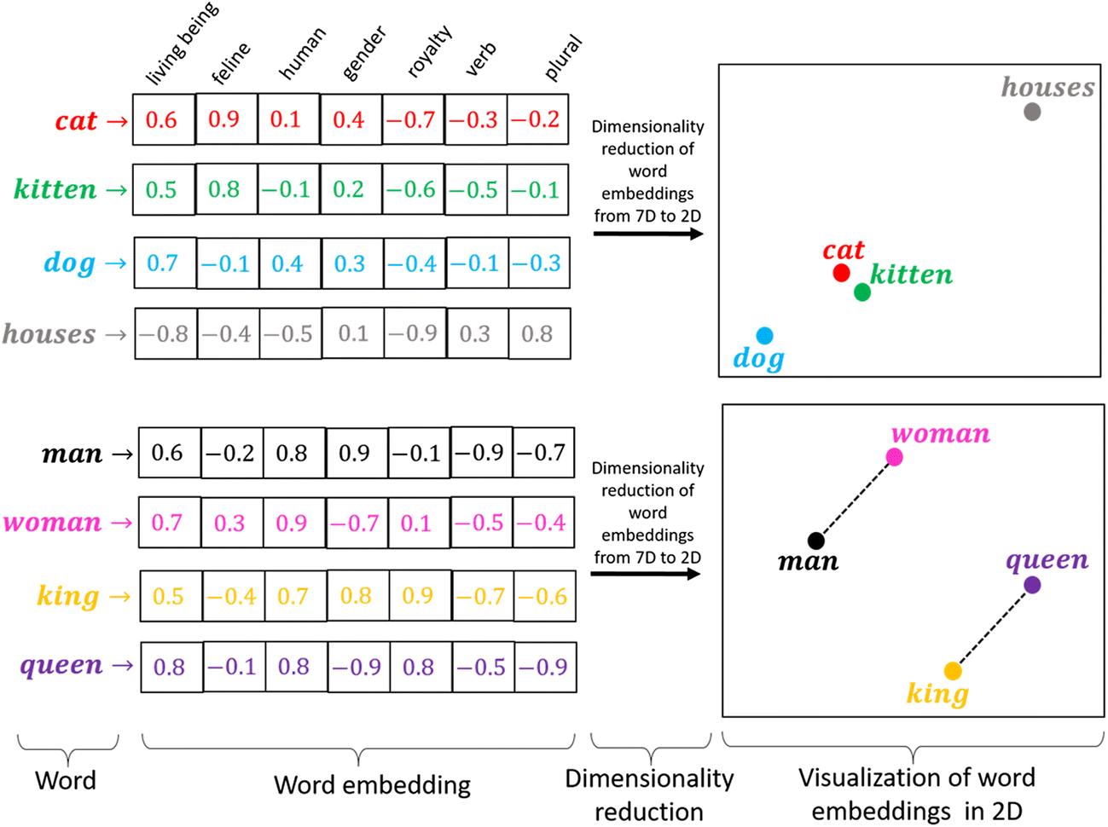
Word Embeddings
A complete set of word embeddings exhibits amazing and useful properties, recognizes words that are similar, and naturally captures the relationships between words as we use them.
This will require a large amount of text data to ensure that useful embeddings are learned, such as millions or billions of words.

Slide 47
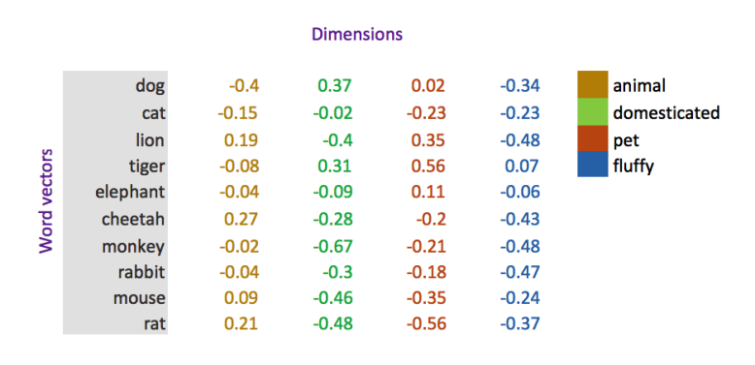
Another Example ☺

Slide 48
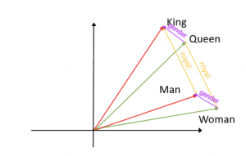
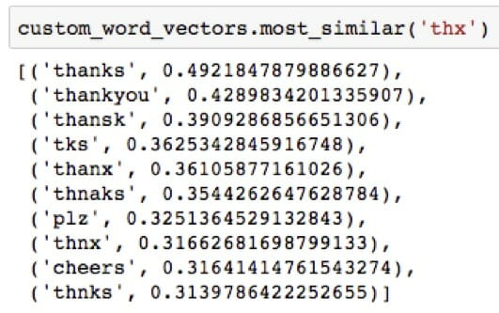
Cosine Similarity

Slide 49
Word Embeddings Dimensions
Word Embedding converts a word to an n-dimensional vector.
Words which are related such as ‘house’ and ‘home’ map to similar n-dimensional vectors, while dissimilar words such as ‘house’ and ‘airplane’ have dissimilar vectors.
In this way the ‘meaning’ of a word can be reflected in its embedding.
Assign each word with a vector typically of length 100–300 dimensions.
This range of vector sizes for the embeddings were shown in the glove paper to be the range with the most useful results.

Slide 50
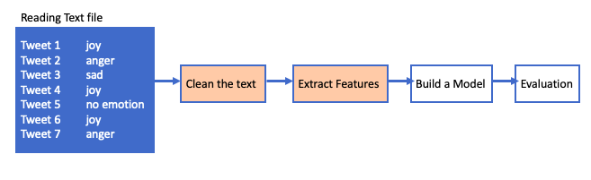
So far!

Slide 51
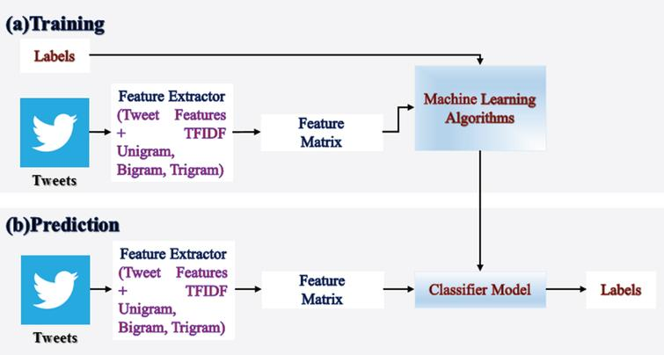
Our Goal

Slide 52
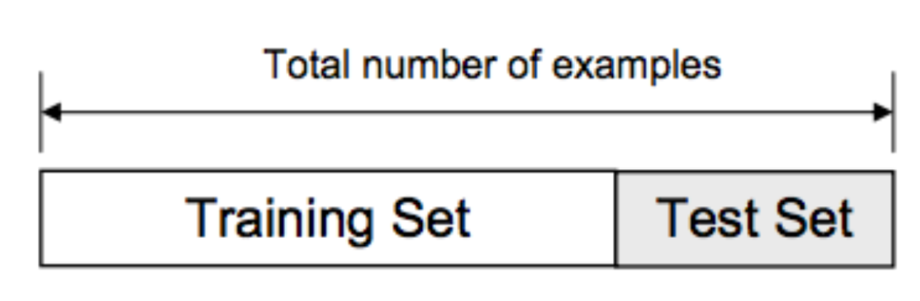
Split the data
We usually split our data into two subsets: training data and testing data (and sometimes to three: train, validate and test), and fit our model on the train data, in order to make predictions on the test data.

Slide 53
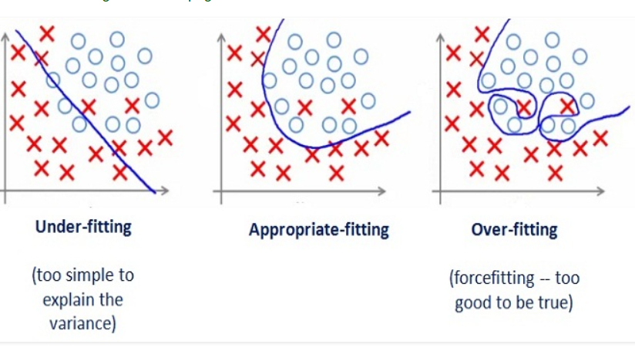
Generalization
Model does a good job of correctly predicting class labels of previously unseen samples.
Generalization is typically evaluated using a test set of data that was not involved in the training process

Slide 54
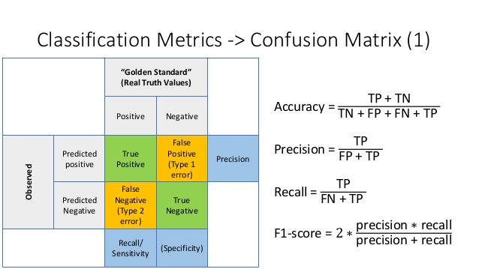
Evaluation

Slide 55

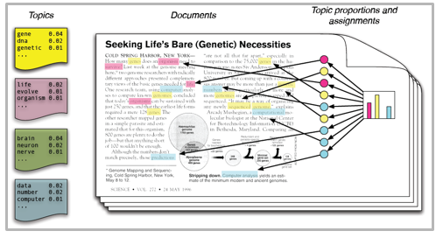
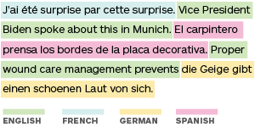
Text Classification Approaches
Text classification is used for sentiment analysis, topic detection, language detection, and others.
The popular classification approaches
Machine Learning
Deep Learning

Slide 56
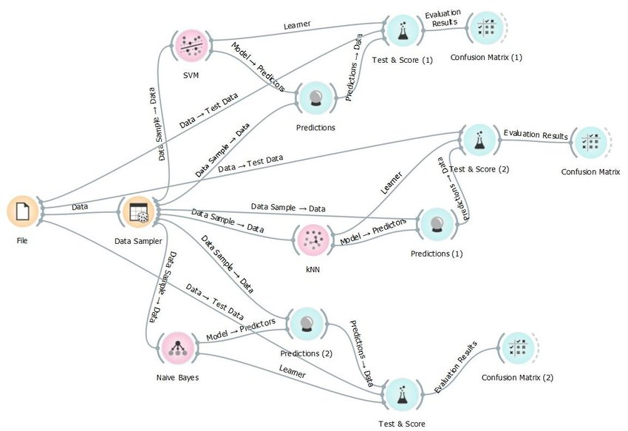
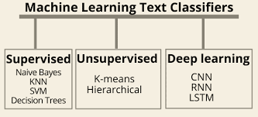
Many Classifiers
Which one to choose?

Slide 57


Machine Learning Approach
Machine-based classifier learns to make a classification based on past observation from the data sets.
User data is prelabeled as tarin and test data.
It collects the classification strategy from the previous inputs and learns continuously.
Machine-based classifier uses different feature extraction techniques

Slide 58


Example

Slide 59




Slide 60



Slide 61

Deep Learning Approach
Deep learning is a set of algorithms and techniques inspired by how the human brain works, called neural networks.
Deep learning architectures offer huge benefits for text classification because they perform at super high accuracy with lower-level engineering and computation.
The two main deep learning architectures for text classification are Convolutional Neural Networks (CNN) and Recurrent Neural Networks (RNN).

Slide 62


Language Models

Slide 63


Biological Neuron

Slide 64


Slide 65

Deep Learning
You can have many hidden layers, which is where the term deep learning comes into play.
In an artificial neural network, there are several inputs, which are called features, and produce a single output, which is called a label.

Slide 66


Text Classification with Deep Learning

Slide 67

We need to jump over this!
Corpus
Word Embedding
But, we will show you the code!

Slide 68
Sentiment Analysis using Word embeddings
import numpy as np import tensorflow as tf import tensorflow_datasets as tfds from tensorflow.keras.preprocessing.text import Tokenizer from tensorflow.keras.preprocessing.sequence import pad_sequences
myFile = tfds.load(‘FileName',as_supervised=True) train, test = myFile['train’], myFile['test']
training_sentences=[] training_labels=[] testing_sentences=[] testing_labels=[]
for sentence,label in train_data: training_sentences.append(str(sentence.numpy())) training_labels.append(label.numpy()) for sentence,label in test_data: testing_sentences.append(str(sentence.numpy())) testing_labels.append(label.numpy())
training_labels_final=np.array(training_labels) testing_labels_final=np.array(testing_labels)

Slide 69
Continue coding!
vocab_size=10000 embedding_dim = 16 # [ a vector of 16 number] max_length = 120 #max length of any review is 120 trunc_type='post' oov_tok = "<OOV>” #if there is any new token, fill it with OOV
tokenizer = Tokenizer (num_words = vocab_size, oov_token=oov_tok) tokenizer.fit_on_texts( training_sentences)
training_sequences=tokenizer.texts_to_sequences(training_sentences) #convert to vector testing_sequences=tokenizer.texts_to_sequences(testing_sentences) #convert to vector
training_padded=pad_sequences(training_sequences, maxlen=max_length, truncating=trunc_type)
testing_padded=pad_sequences(testing_sequences, maxlen=max_length, truncating=trunc_type)

Slide 70
Continue coding!
model = tf.keras.Sequential ([ tf.keras.layers.Embedding (vocab_size, embedding_dim, input_length=max_length), tf.keras.layers.Flatten ( ), tf.keras.layers.Dense (6, activation='relu'), tf.keras.layers.Dense (1, activation='sigmoid') ])
model.compile(loss='binary_crossentropy’, optimizer='adam’, metrics=['accuracy’])
model.summary()
Corpus
Word Embedding

Slide 71

Very Expensive to work with DL
Training a natural language model can be expensive. It requires lots of data that data needs to be labelled by humans, and it can take lot of time to train on expensive hardware.
GPT-2, a benchmark-setting language model released in 2019 by Open AI, is estimated to have cost around $1.6m to train.
With costs like that, how is anybody going to compete with Open AI or any of the other organizations doing research in the NLP space?

Slide 72

Good News
You don’t need to compete with them.
You can download these pre-trained language models for free on the internet, pre-trained on enormous datasets and ready to go.
What’s even better is that you can fine-tune these models really quickly to work on the nuances of your specific dataset.

Slide 73

Transfer Learning

Slide 74

Why Transfer Learning Now?
Andrew Ng, chief scientist at Baidu and professor at Stanford, said during his widely popular NIPS 2016 tutorial that transfer learning will be -- after supervised learning -- the next driver of ML commercial success.

Slide 75

Advanced Topics
Applying BERT and RoBERTa

Slide 76

BERT vs RoBERTa
Open Source BERT by Google: Bidirectional Encoder Representations from Transformers, or BERT, is a self-supervised method released by Google in 2018.
Beginning of the Optimization of BERT: Introduction to RoBERTa
Facebook’s RoBERTa: An optimized method for pretraining self-supervised NLP systems

Slide 77


HuggingFace
The team over at HuggingFace have done an incredible job of making these models incredibly easy to use.
You can basically load up these pre-trained models with just a couple lines of code and start experimenting with the possibilities.

Slide 78
You are ready to Go ☺
Collect your data
Annotate your data by experts in the domain
Clean the data
Extract Feature
Apply a Classifier
Evaluate your model (accuracy, recall, precision, f1 score)
Using BERT or RoBERTa

Slide 79


We got our data from a shared task (SemEval 2019 Task 3: EmoContext):
ID | Turn1 | Turn2 | Turn3 | label
1026 | cool | :D ^_^ thnx | haha!! am fine with nicknames .. have loads of it | happy
9028 | Haha | Heh good one | 😂 😂 | happy
1079 | Let my message to be last one now | I will | Don't message me | angry
1105 | I am getting angry on you | Why? | you are not responding me properly | angry
1164 | Love you so much | Anytime happy holidays(; | I don't have holiday | sad
 | Train | Dev | Test
Anger | 5506 | 150 | 298
Happy | 4243 | 142 | 284
Sad | 5463 | 125 | 250
Other | 14948 | 2338 | 4677
Total | 30160 | 2755 | 5509

Slide 80

Deep Learning Models

Slide 81
I Usually Do This
Setup: Importing Libraries
Loading the data set & Exploratory Data Analysis
Text pre-processing
Extracting vectors from text (Vectorization)
Running ML/DL algorithms
Evaluate the Algorithms
Compare the results

Slide 82


Good References
https://www.coursera.org/learn/machine-learning
https://www.coursera.org/learn/neural-networks-deep-learning

Slide 83
Thank you
Any questions?

